Slide 1
Service Versioning
Policy Update
Denis Baltor
22/06/2017
V1.4

Slide 2
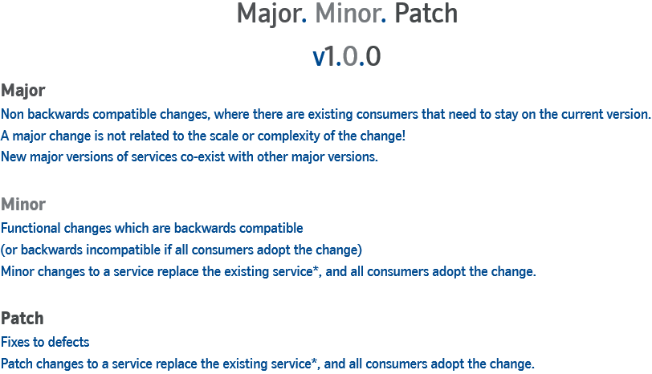
Current Policy

Slide 3

Current Policy and Compatibility
MAJOR v. –> backward-incompatible change
MINOR v. –> backward-compatible and
backward-incompatible changes
(depending on the consumers’ adoption)
PATCH –> backward-compatible fix

Slide 4

Current Project-based Development Process
Backward-incompatible MINOR change
with only one consumer scenario
NEM CIT
DataPower
STPO
IIB
V1.0
V1.0
V1.0
Channel
Project Team

Slide 5
Current Project-based Development Process
Backward-incompatible MINOR change
with only one consumer scenario
NEM CIT
DataPower
STPO
IIB
Channel
✔
✔
✔
V1.1
V1.1
V1.1
Project Team

Slide 6
Current Policy’s Undesired Side Effects
Complexity. As we evolve NEM creating new service versions, the complexity is building up.
Work (development, test, deployment) on different services have to be synchronised when a contract breaking change is carried out as a MINOR change. This force us to follow the current release-based approach.

Slide 7
Driving Forces and Business Challenges
Services are to be autonomous. They must be entities capable of being independently deployed, versioned, and managed.
Different teams need to work on different services in any timescales.
NEM DC need to support multiple parallel projects (Continuous Integration).
NEM DC need to evolve to deliver small changes anytime (Continuous Deployment).

Slide 8
Product-based CI Development Process
Backward-incompatible change
with only one consumer scenario
NEM CIT
DataPower
STPO
IIB
V1.0
V1.0
V1.0
Channel

Slide 9
Product-based CI Development Process
Backward-incompatible change
with only one consumer scenario
NEM CIT
DataPower
STPO
IIB
V1.0
V1.0
V1.0
Channel
✔
V2.0
Product A Team

Slide 10
Product-based CI Development Process
Backward-incompatible change
with only one consumer scenario
NEM CIT
DataPower
STPO
IIB
V1.0
V1.0
V1.0
Channel
✔
✔
V2.0
V2.0
Product C Team

Slide 11
Product-based CI Development Process
Backward-incompatible change
with only one consumer scenario
NEM CIT
DataPower
STPO
IIB
V1.0
V1.0
V1.0
Channel
✔
✔
✔
V2.0
V2.0
V2.0
Product B Team

Slide 12
Product-based CI Development Process
Backward-incompatible change
with only one consumer scenario
NEM CIT
DataPower
STPO
IIB
Channel
✔
✔
✔
V2.0
V2.0
V2.0

Slide 13
Updated Policy and Compatibility
MAJOR v. –> backward-incompatible change
MINOR v. –> backward-compatible change
PATCH –> backward-compatible fix

Slide 14
Updated Policy

